Slide 1

Internet of Things:
VP-Dibris Smart Parking
Accomplished by: Rakhmetov Osman-Aldiyar (4903253)

Slide 2
Content
About project
Devices/sensors & technology stack
Architecture
Logic
Further possible improvements

Slide 3
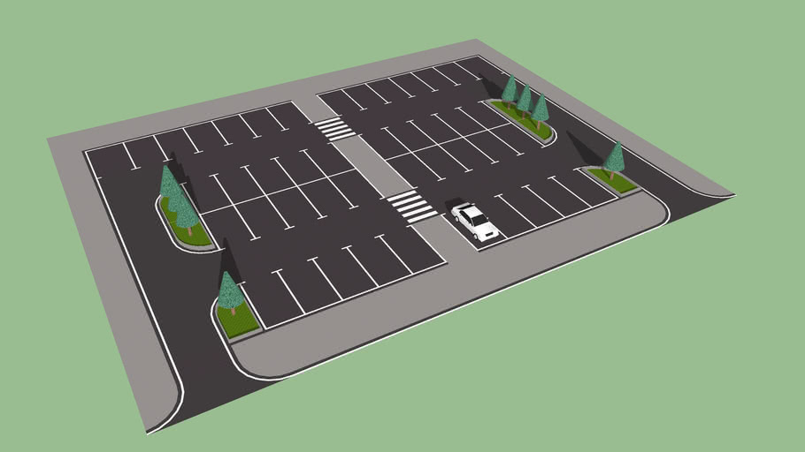
About project
Out of 2 possible options:
Option 1: VP-Dibris Smart Parking
Option 2: Bridge Digital Twin
Option 1 was chosen;

Slide 4
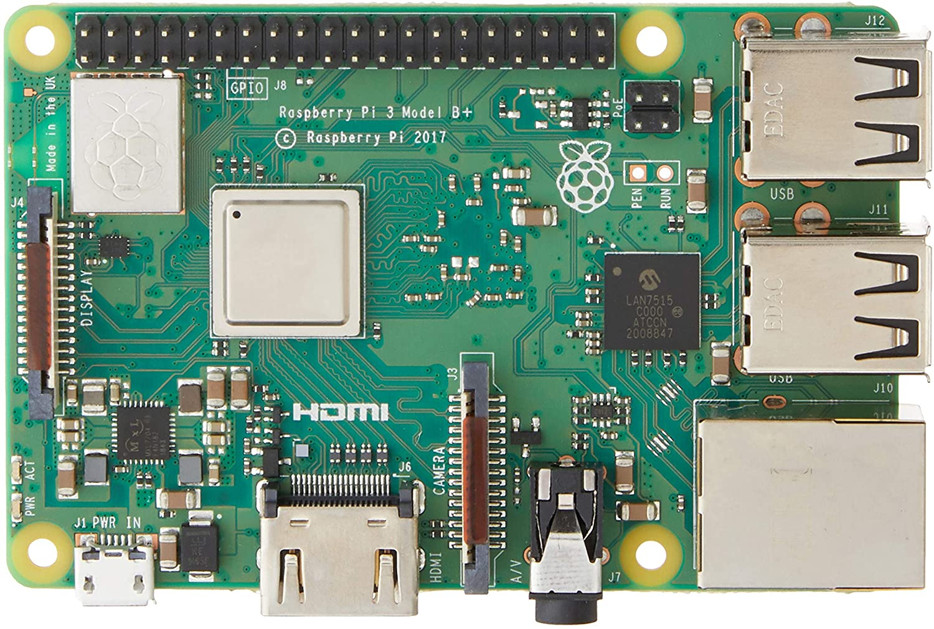
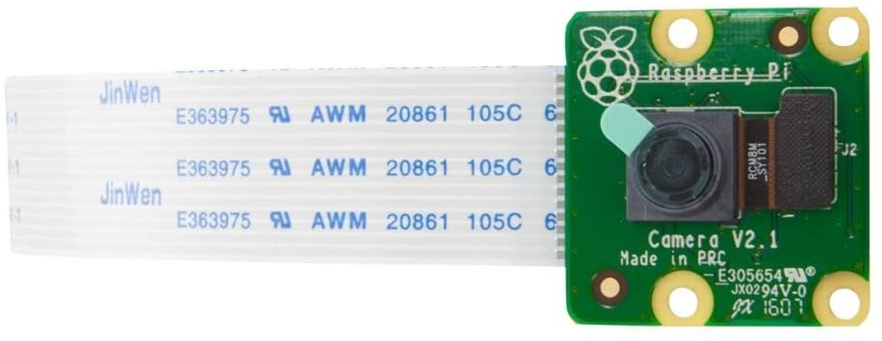
Devices/sensors & technology stack
Devices and Sensors:
Raspberry PI 3 model b (x2):
Raspberry PI Camera module V2 (x2):

Slide 5
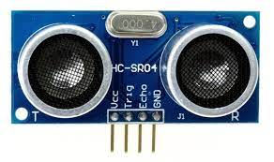
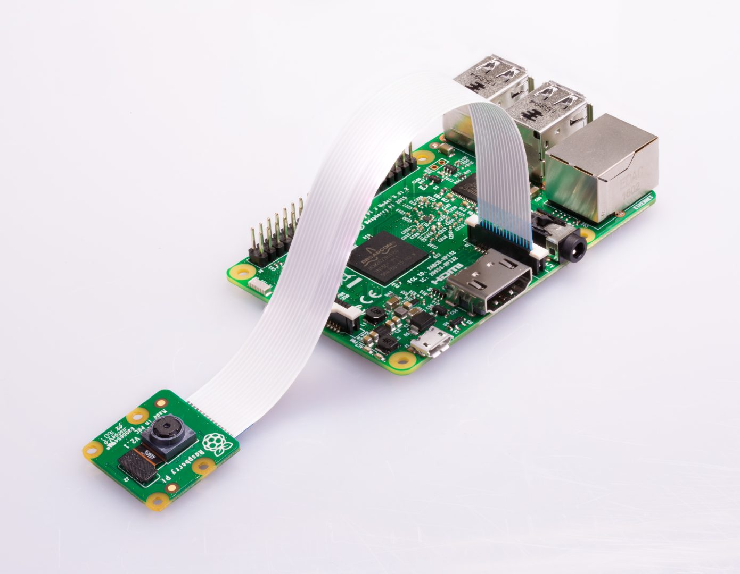
Devices/sensors & technology stack
Ultrasonic sensors HC-SR04 (2x) :
The connection between Camera and RPi will happen over ZIF 15 Connector and CSI Ribbon Cable.

Slide 6
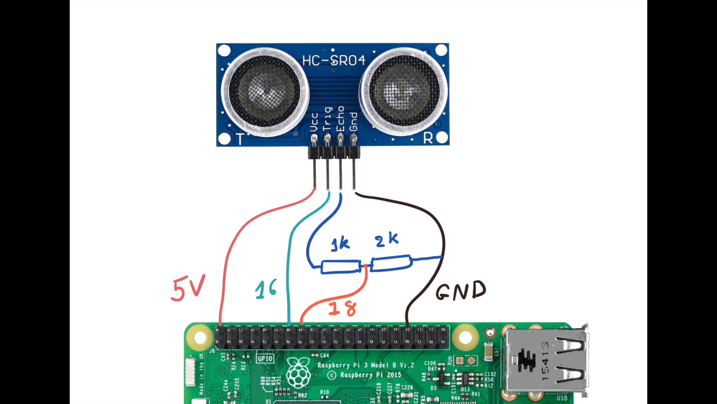
Devices/sensors & technology stack
HC-SR04 works at 5V
Raspberry Pi works at 3.3V
Before connecting the Echo Pin to the Raspberry Pi, it must be given to a level converter

Slide 7
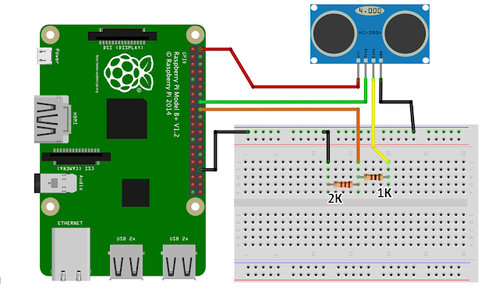
Devices/sensors & technology stack

Slide 8

Devices/sensors & technology stack
OpenALPR is an Automatic License Plate Recognition (ALPR) software used to identify license plate numbers from a picture or image. You have the option of installing the OpenALPR SDK on-premise, or use there cloud service to perform the ALPR.
Notice that OpenALPR is licensed software, but you may sign up for a free account that allows you to perform up to 1000 ALPR’s a month for free.

Slide 9
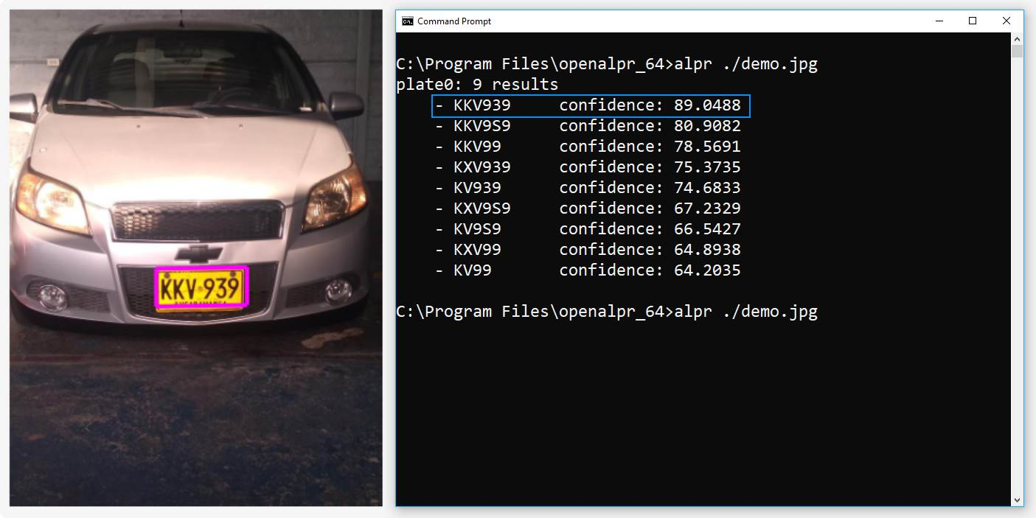
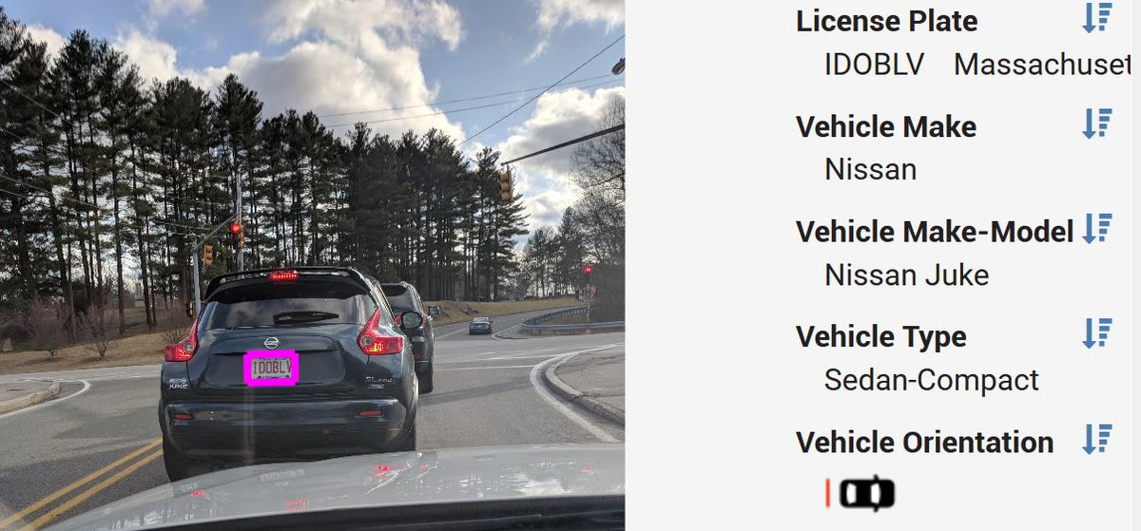
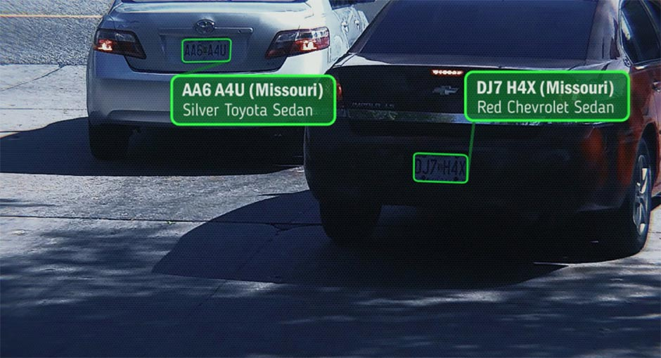
Devices/sensors & technology stack

Slide 10
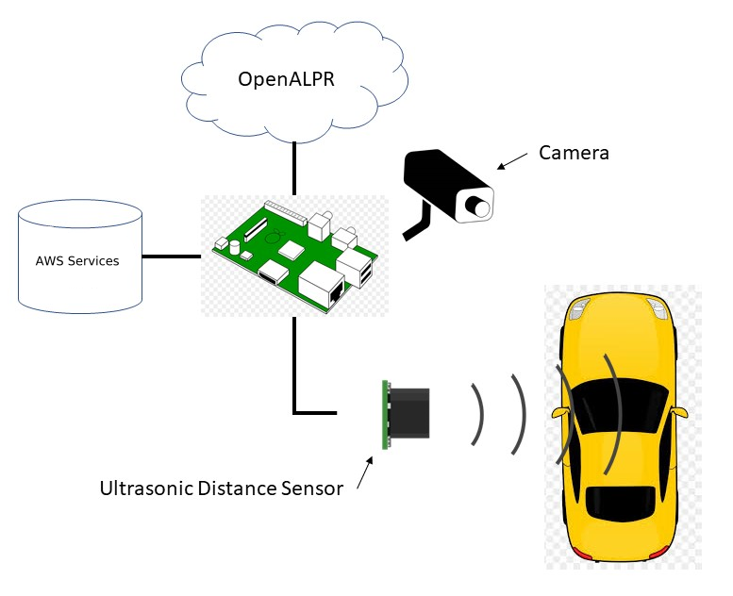
Devices/sensors & technology stack

Slide 11






Devices/sensors & technology stack

Slide 12
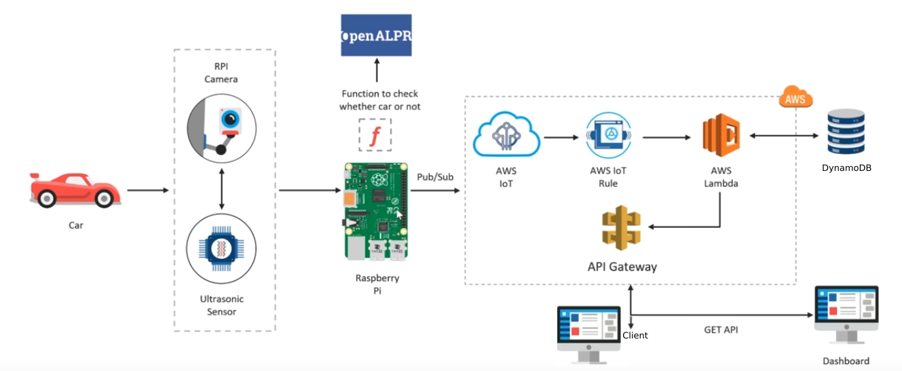
Architecture

Slide 13
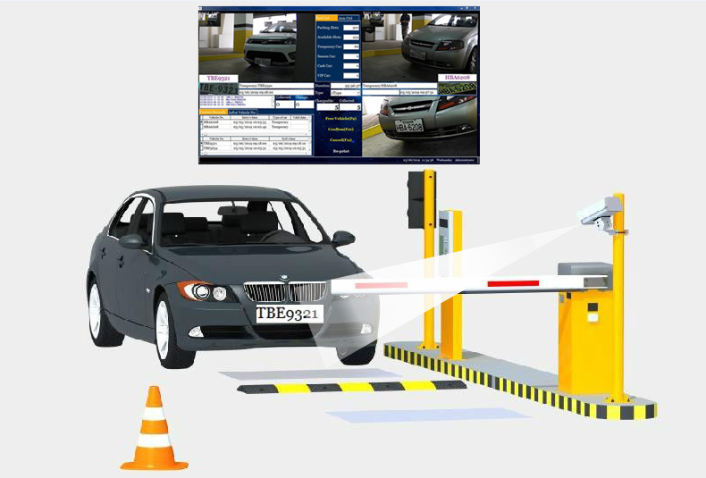
Logic
1 ultrasonic and 1 Raspberry Pi with camera module will be placed at the entrance
1 ultrasonic and 1 Raspberry Pi with camera module will be placed at the exit
For booking the lots client application will be used which will be situated immediately after the entrance

Slide 14
Demo
Let’s switch to the demo

Slide 15
Further possible improvements
1) Server side pagination (is not possible in dynamodb because no previous/next buttons logic support) and sorting
2) Additional analytical charts adjusted to customer’s needs
3) Additional 3rd party application which can be used for booking the parking lot
4) Payment system
5) Authentication for the dashboard
6) Architecture can be adjusted and changed according to your needs. There are other possible implementations.
And many more. No limits to perfection.

Slide 16
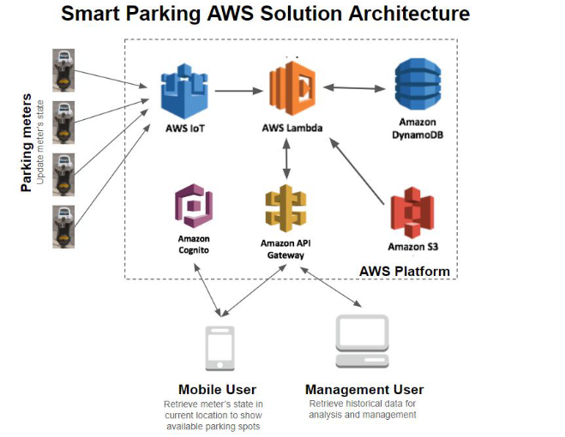
Other possible architecture
Set multiple ultrasonic/magnetic sensors for each lot. (choice depends on the accuracy and cost).
Also video cameras​ using object detection techniques could also be an option in the near
future, as currently the cost of implementing could be much higher than the above
options, while providing the same information (occupancy).
GPS for identifying the car location. Displaying the route to the nearest parking lot to the customer’s car (DynamoDB supports GPS geohashing indices for efficient execution of location-based queries over DynamoDB items representing the parking
meter location around the downtown.).

Slide 17
Connectivity technology options:
Regarding connectivity suitable for this solution, following are the options;
- Cellular data communication:​ GSM modems for cellular (3G/2G) data communications
are readily available and might be the best option considering most of the parking meters
installed today are already using these channels for payment authorization. Unless the
sensor includes this communication and operates independently, it would be convenient
to connect the sensor to the meter to re-use this communication channel.
- LoRA (Long-Range) communication:​ as an option, this LPWAN technology is being used
in many outdoor use cases, so it could be a good alternative to the cellular technology,
in terms of cost and power consumption (as most of the meters operates from batteries
with solar panels for rechargement).
- Other technologies:​ NB-IoT, LTE-M and 5G might be a good option in the near

